Slide 1
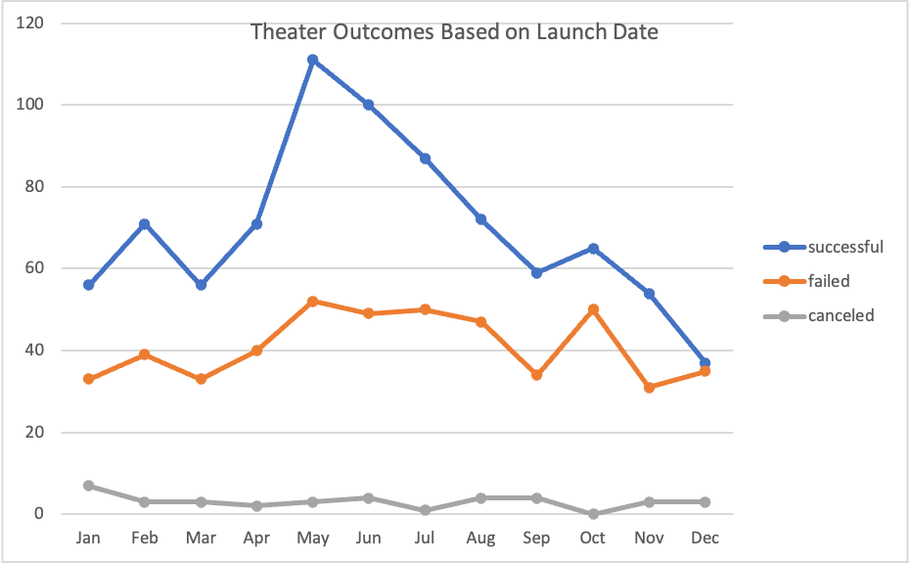
What are two conclusions you can draw about the Outcomes based on Launch Date?
No matter which month, successful kickstarter’ plays were higher than failed and canceled ones.
For the successful kickstarter’plays there is a high peak in May and then a low peak in December. While the failed kickstarter’plays had very little change throughout the year. In addition, the canceled kickstarter’plays also had little to know change and were always on very low numbers.

Slide 2
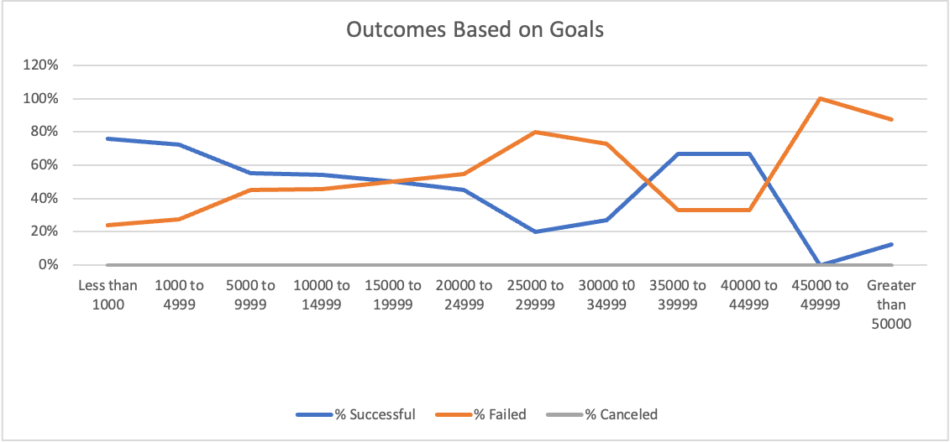
What can you conclude about the Outcomes based on Goals?
By the point where the goal surpasses $20,000 the rate of successful kickstarter’ plays start to decline.
So it seems like in order to have a successful kickstarter the goal shouldn’t be above $20,000.

